Slide 1
The London Meed Junior Governors present…….
Our 5 School Values

Slide 2
Who are your Junior Governors?
Angus, Freddie, Alice and Caitlin (Senior Team)
Plus the Buddies…..
Freddie, Caitlin and Jesse
Sami and Molly
Sebastian and Connall
Lucy and Milo
Lola and Olivia
Angus ,Alice and EYFS
And finally ……Mrs Cole and Mrs Davey

Slide 3
What were we asked to do?
Take photos of our school values
Upload to a shared drive
Show progression of values through the school
Work with a buddy

Slide 4
How did we do this?
Worked with a partner
Ask our class
Shared ideas with the other Junior Governors
Asked for advice and permission from teachers
Made arrangements to visit classes
Used evidence to produce presentation

Slide 5
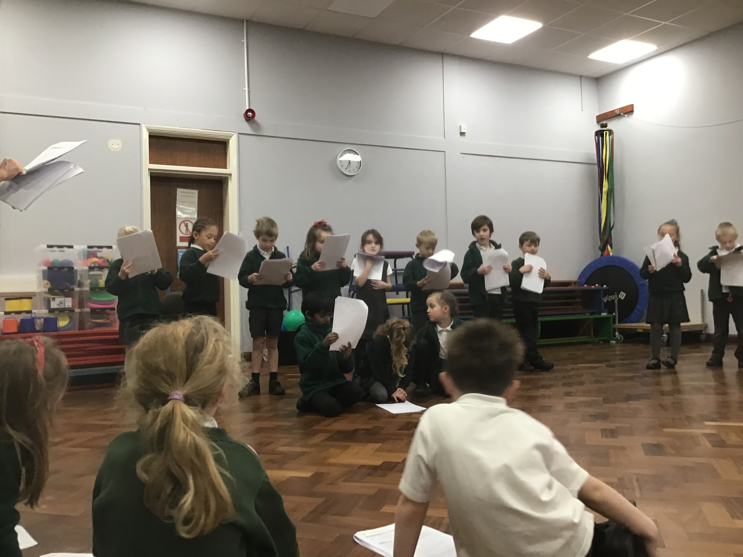
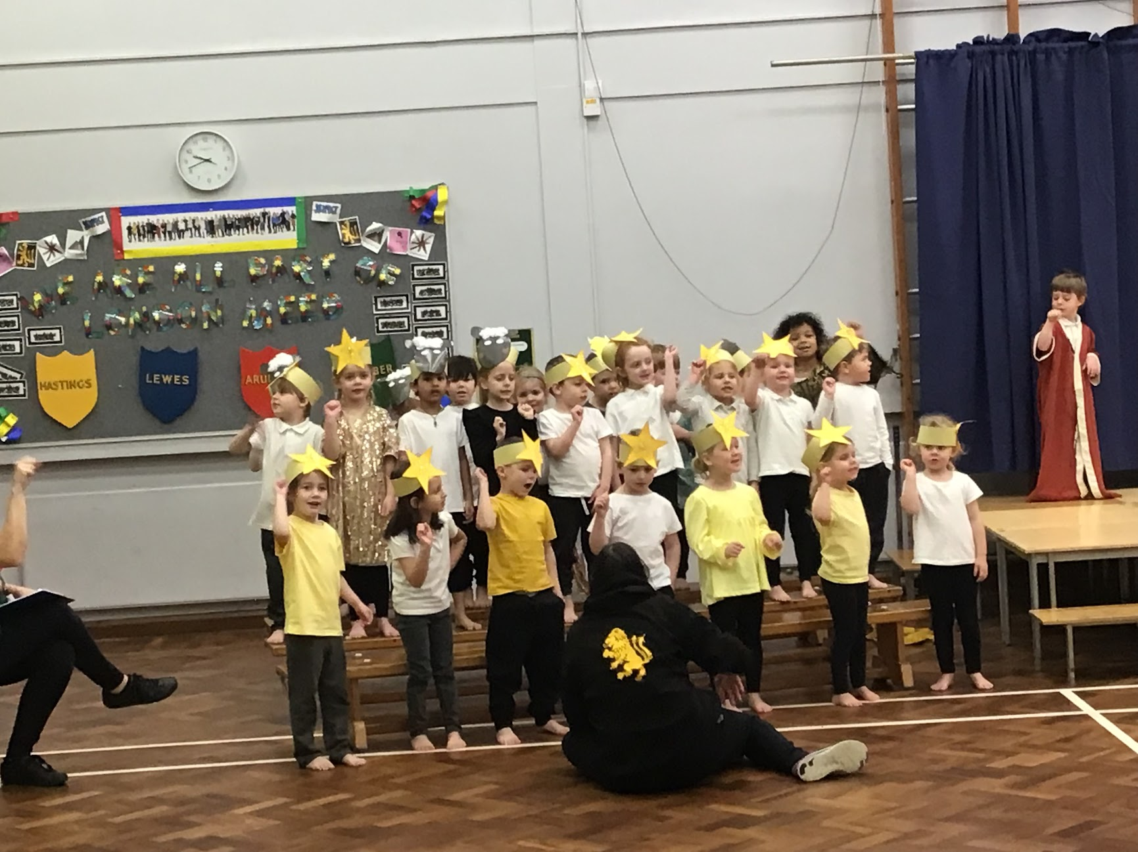
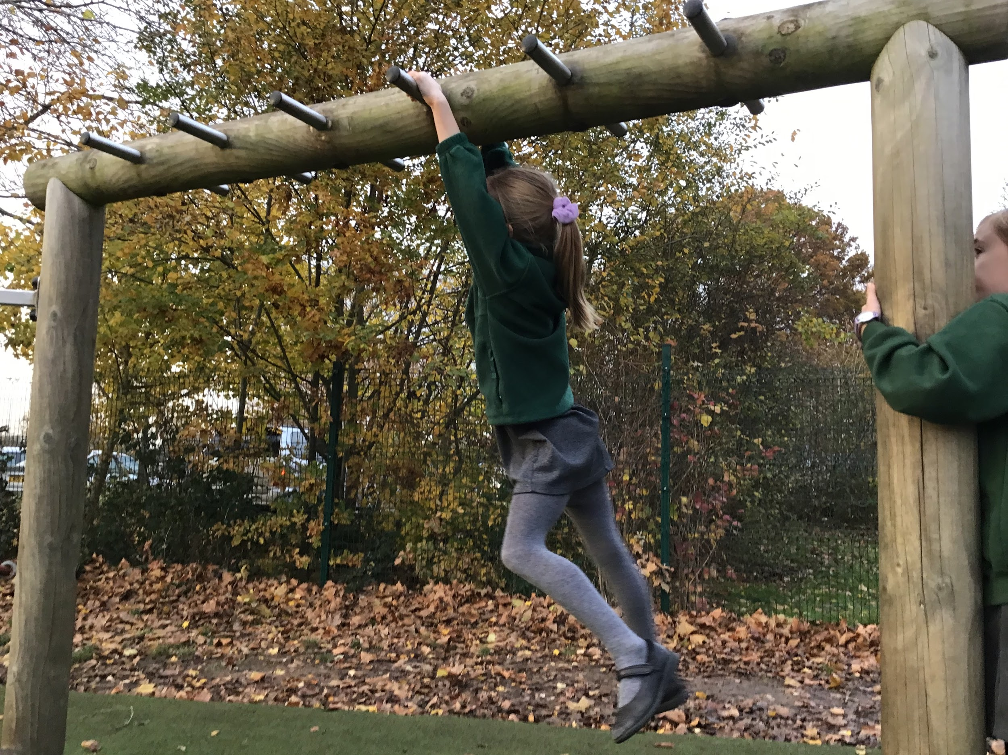
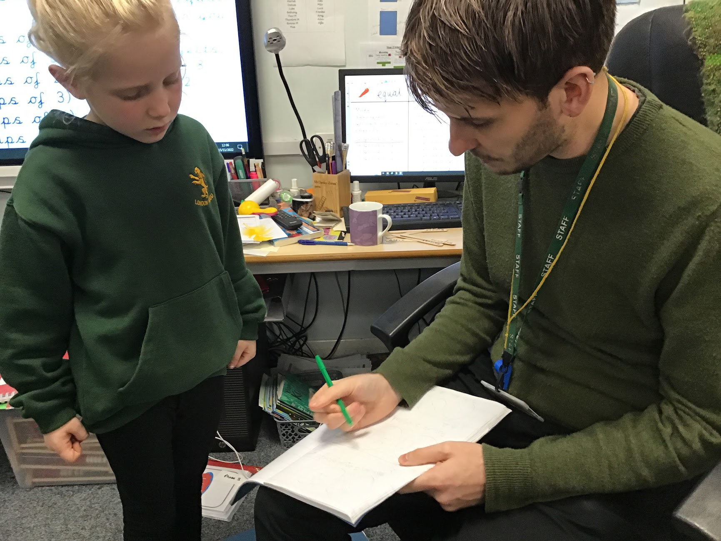
Bravery

Slide 6
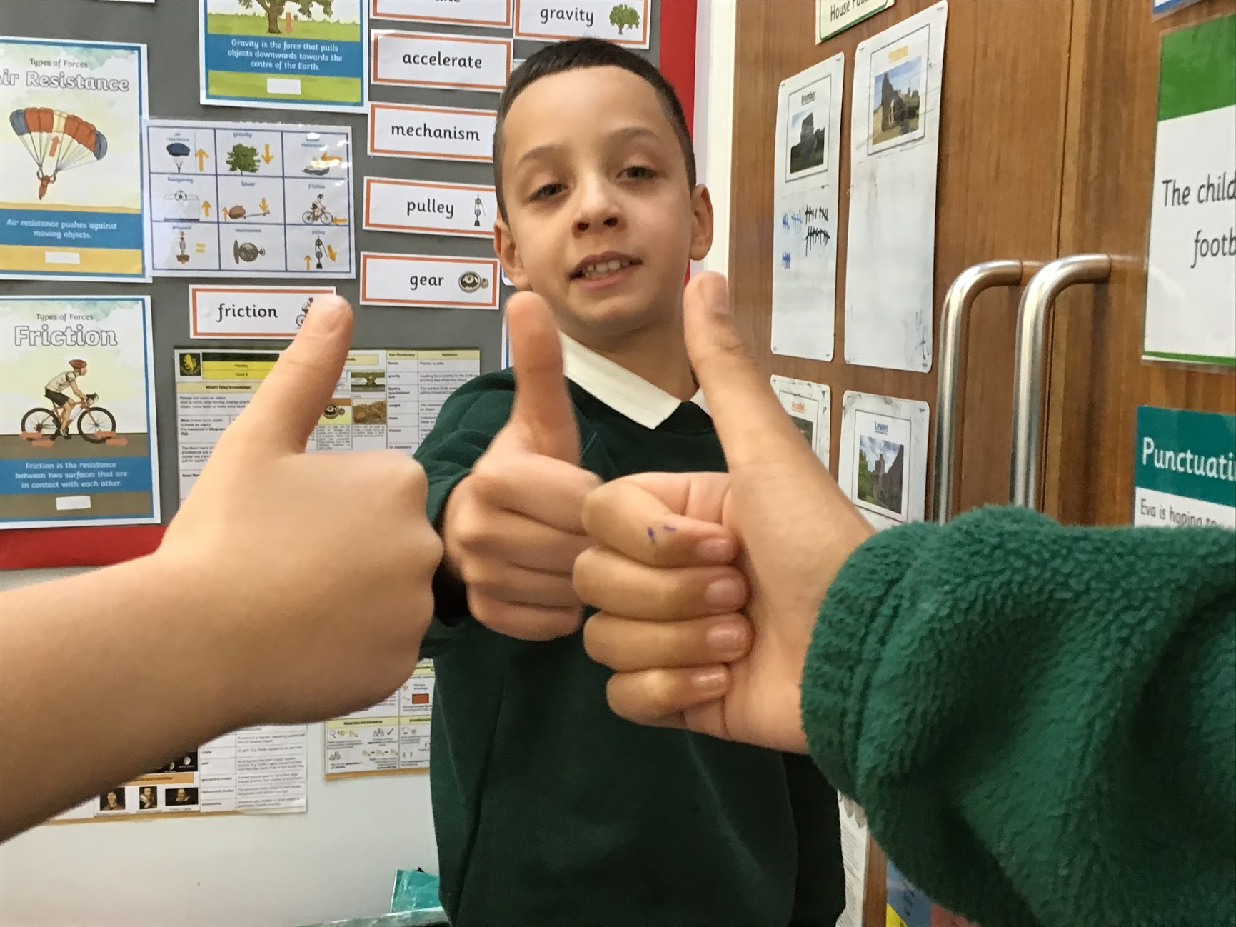
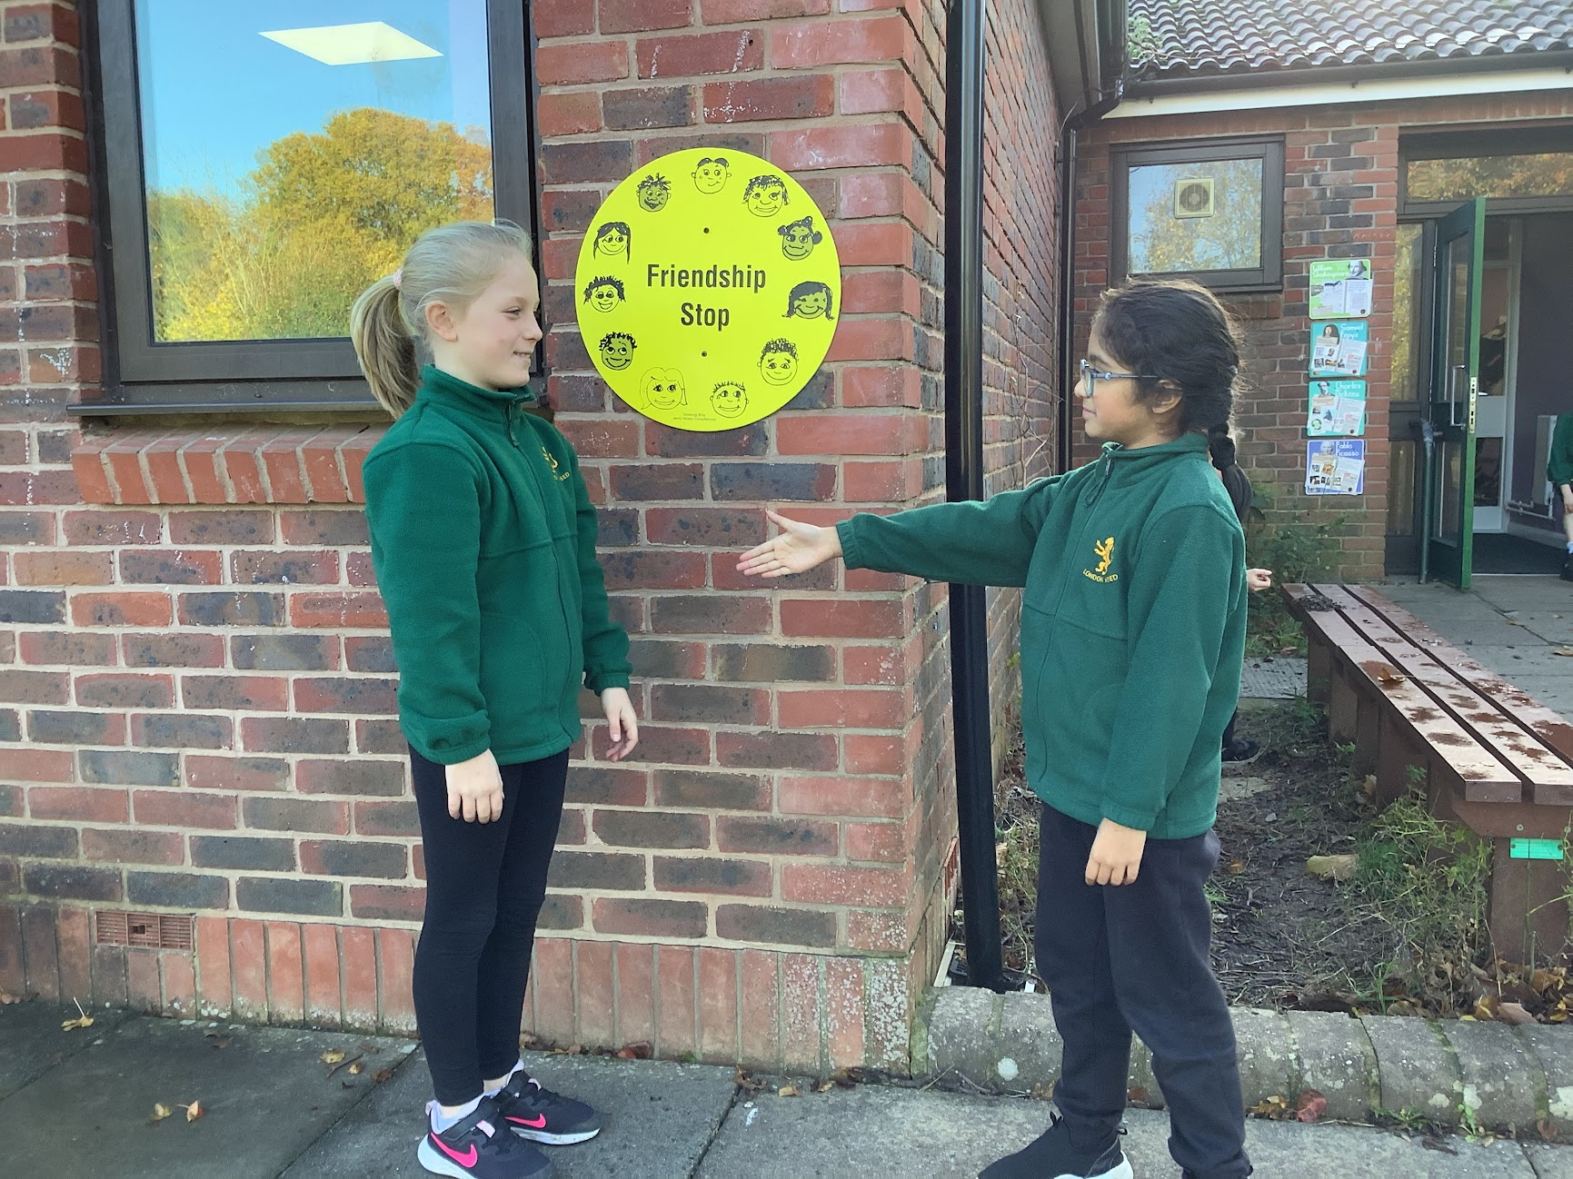
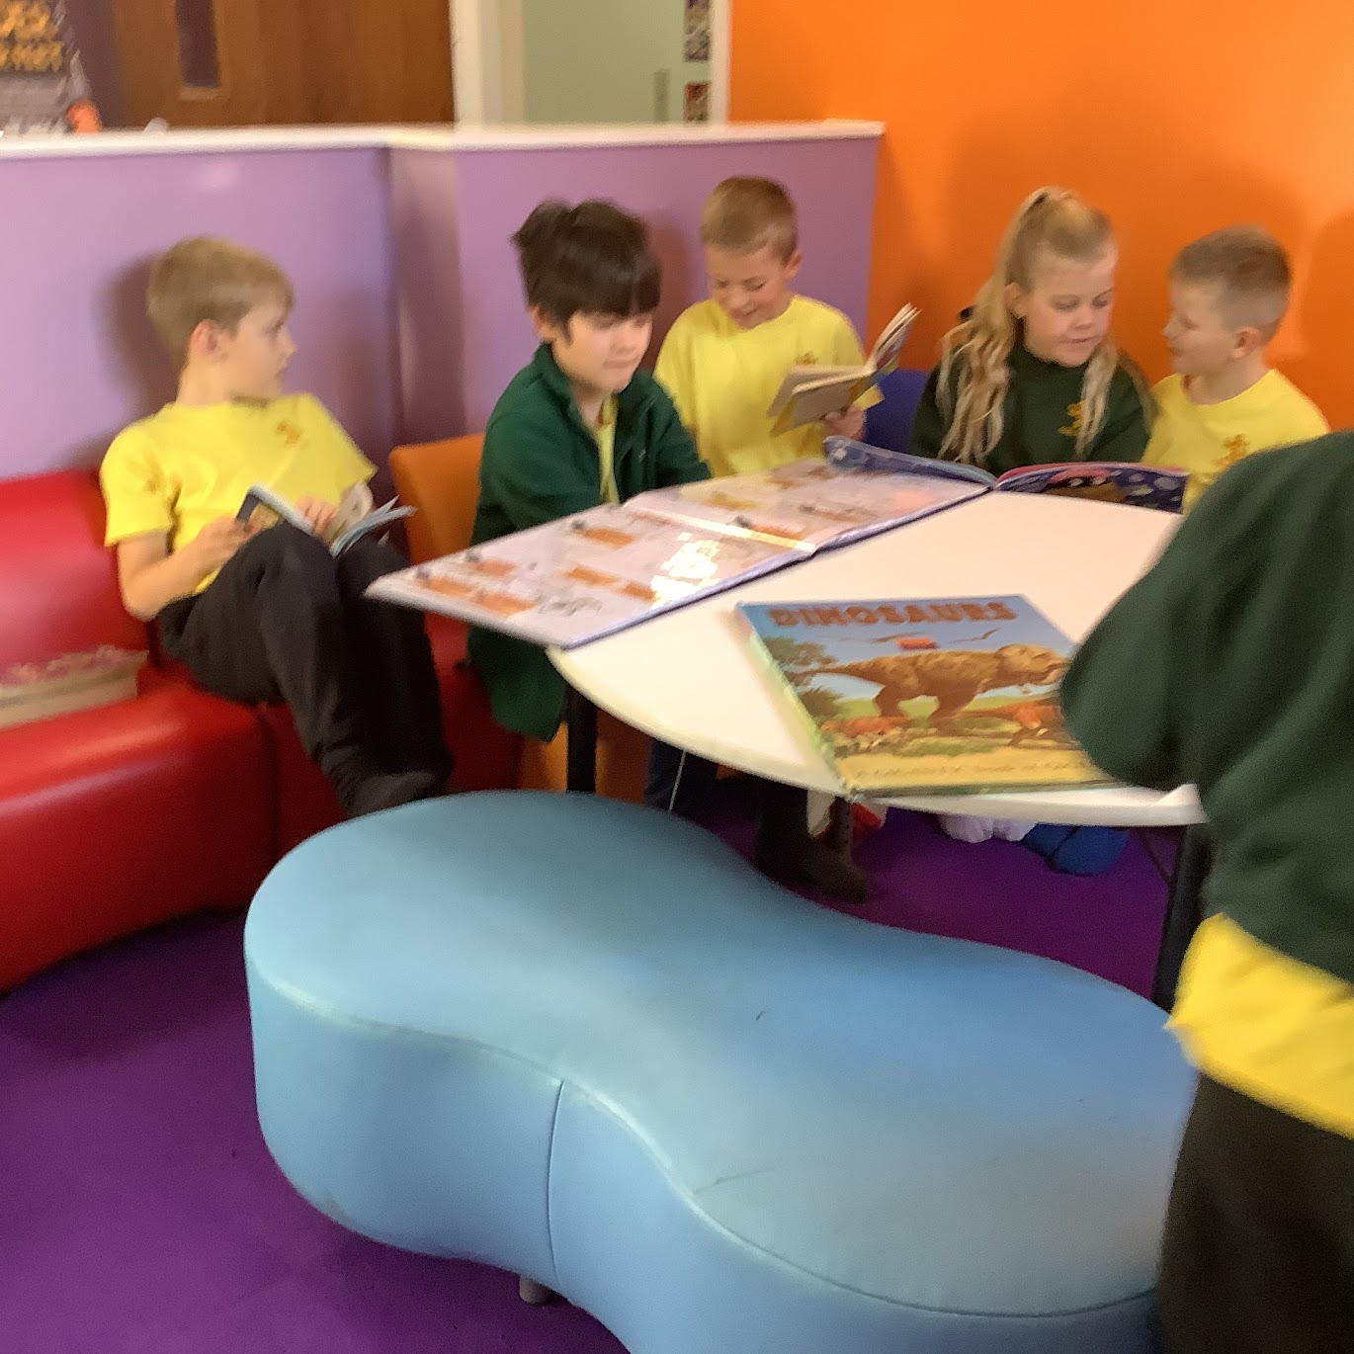
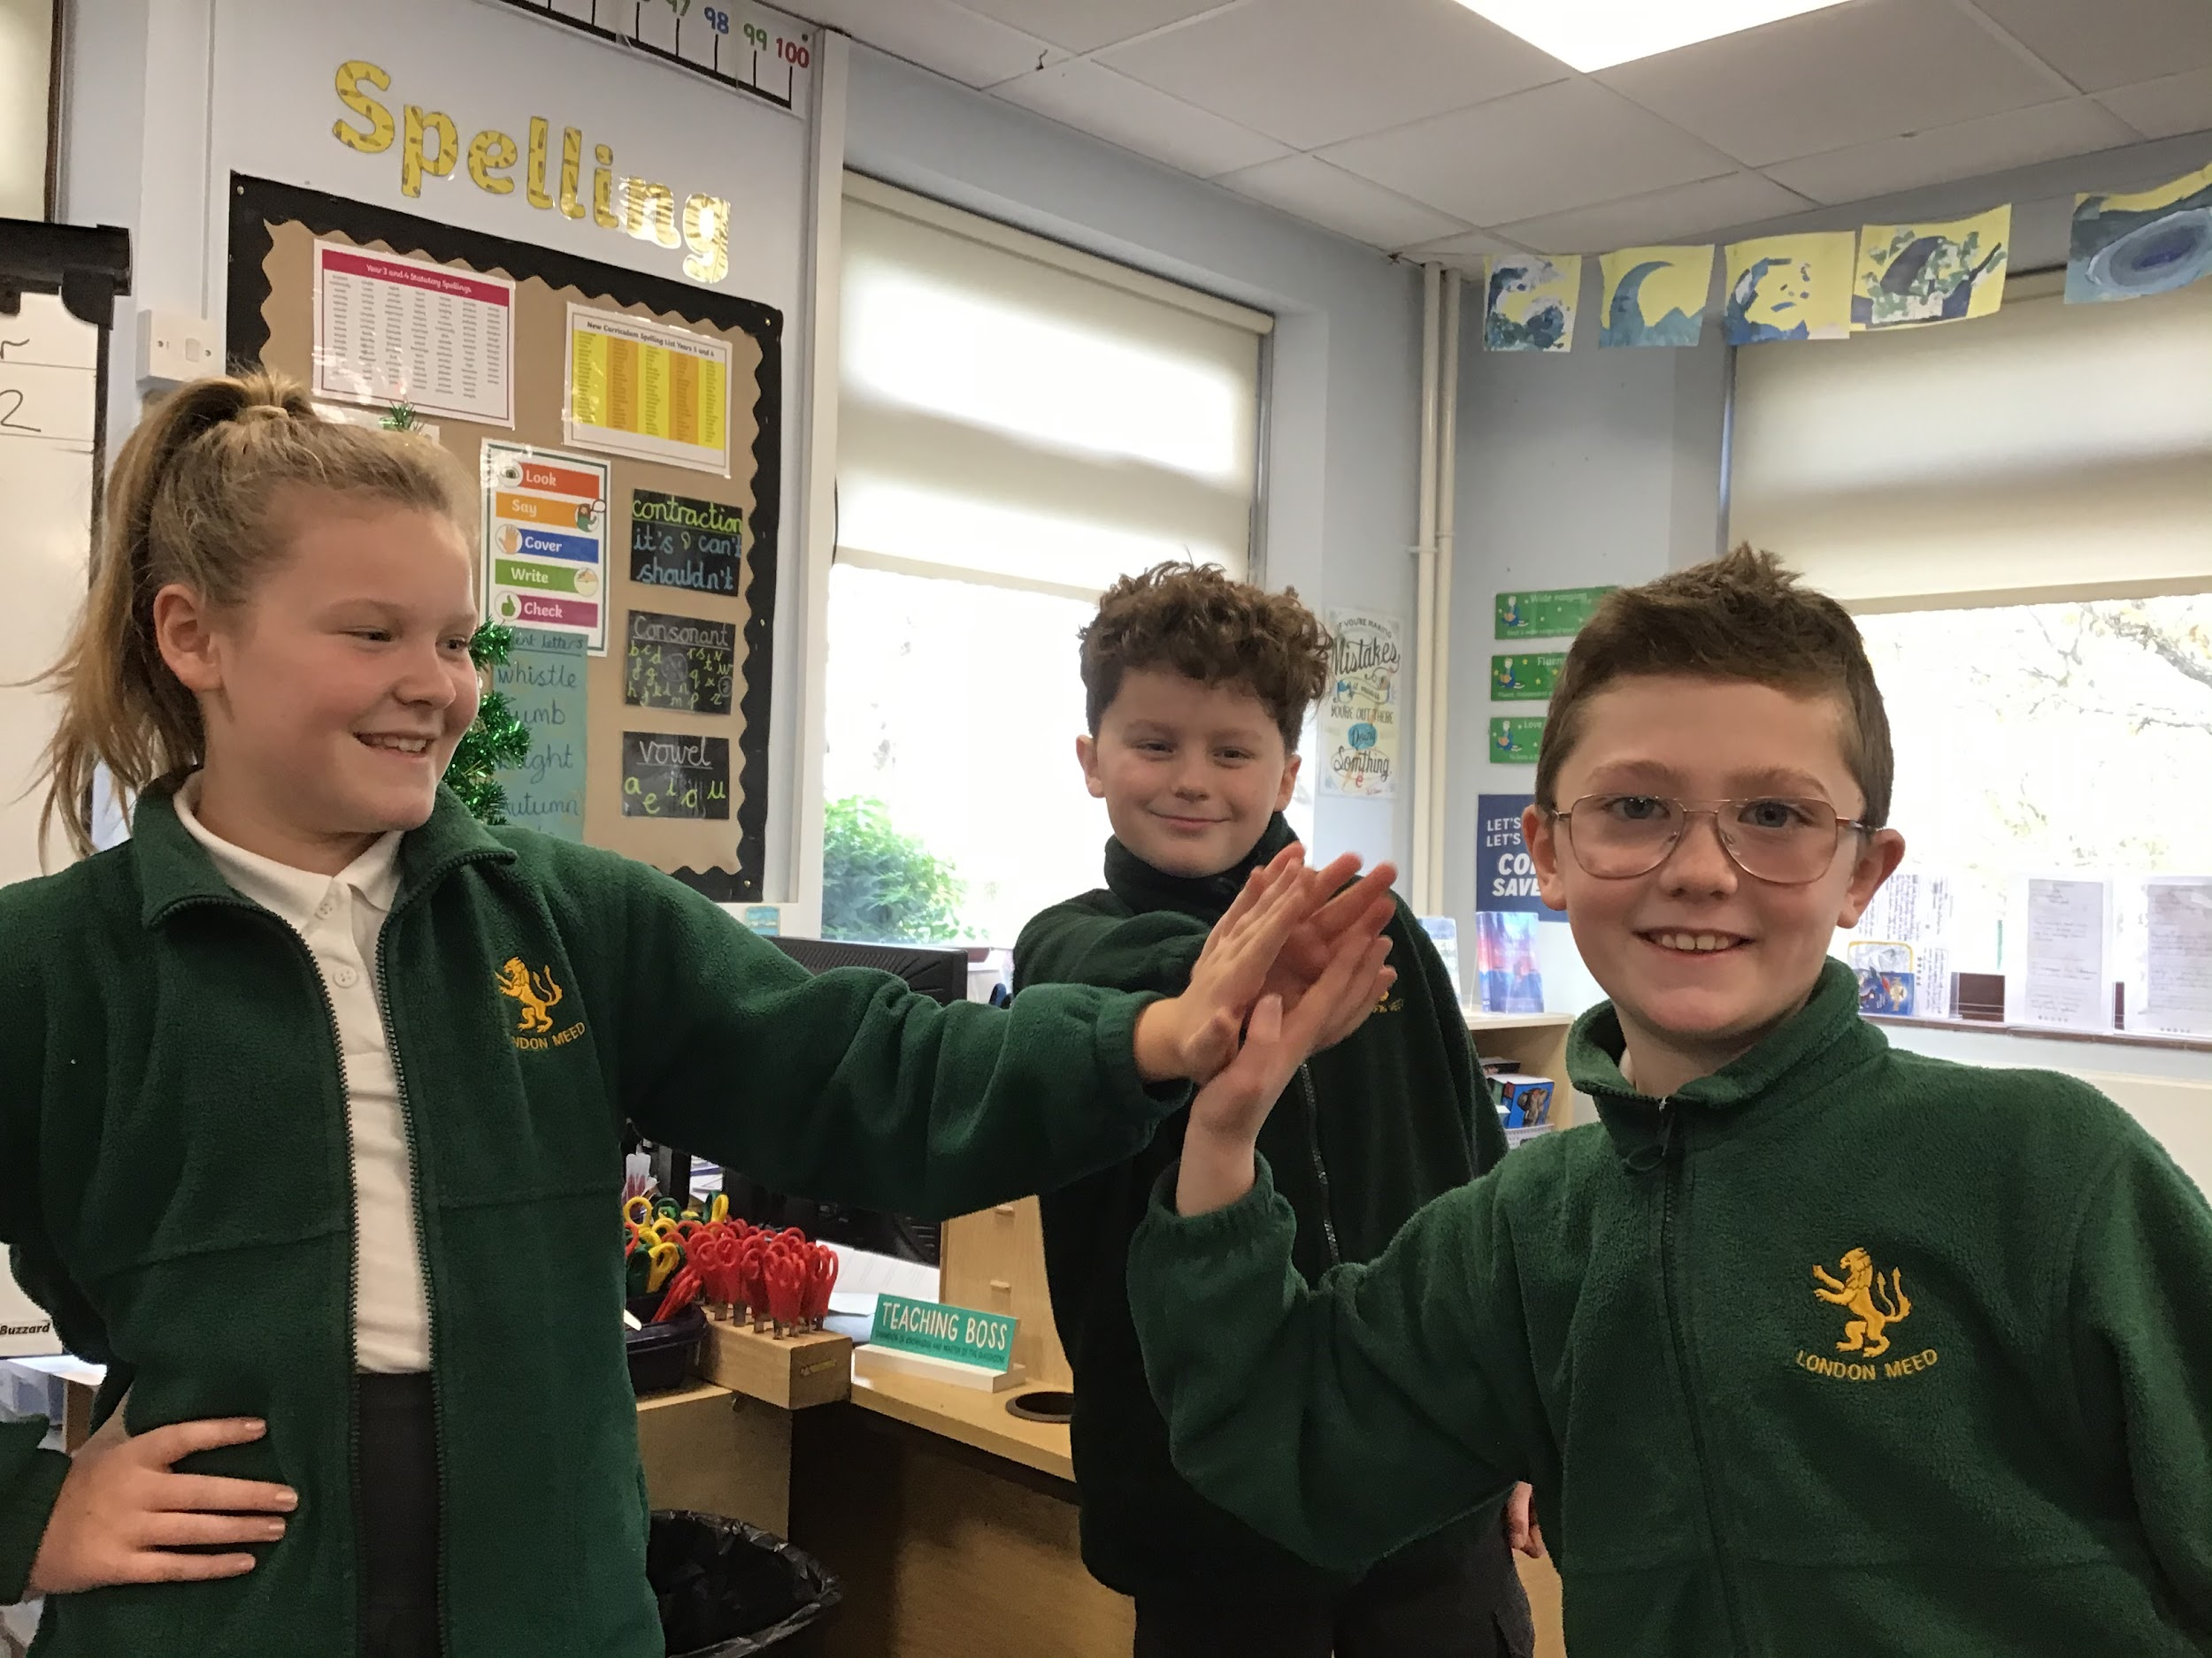
Community

Slide 7
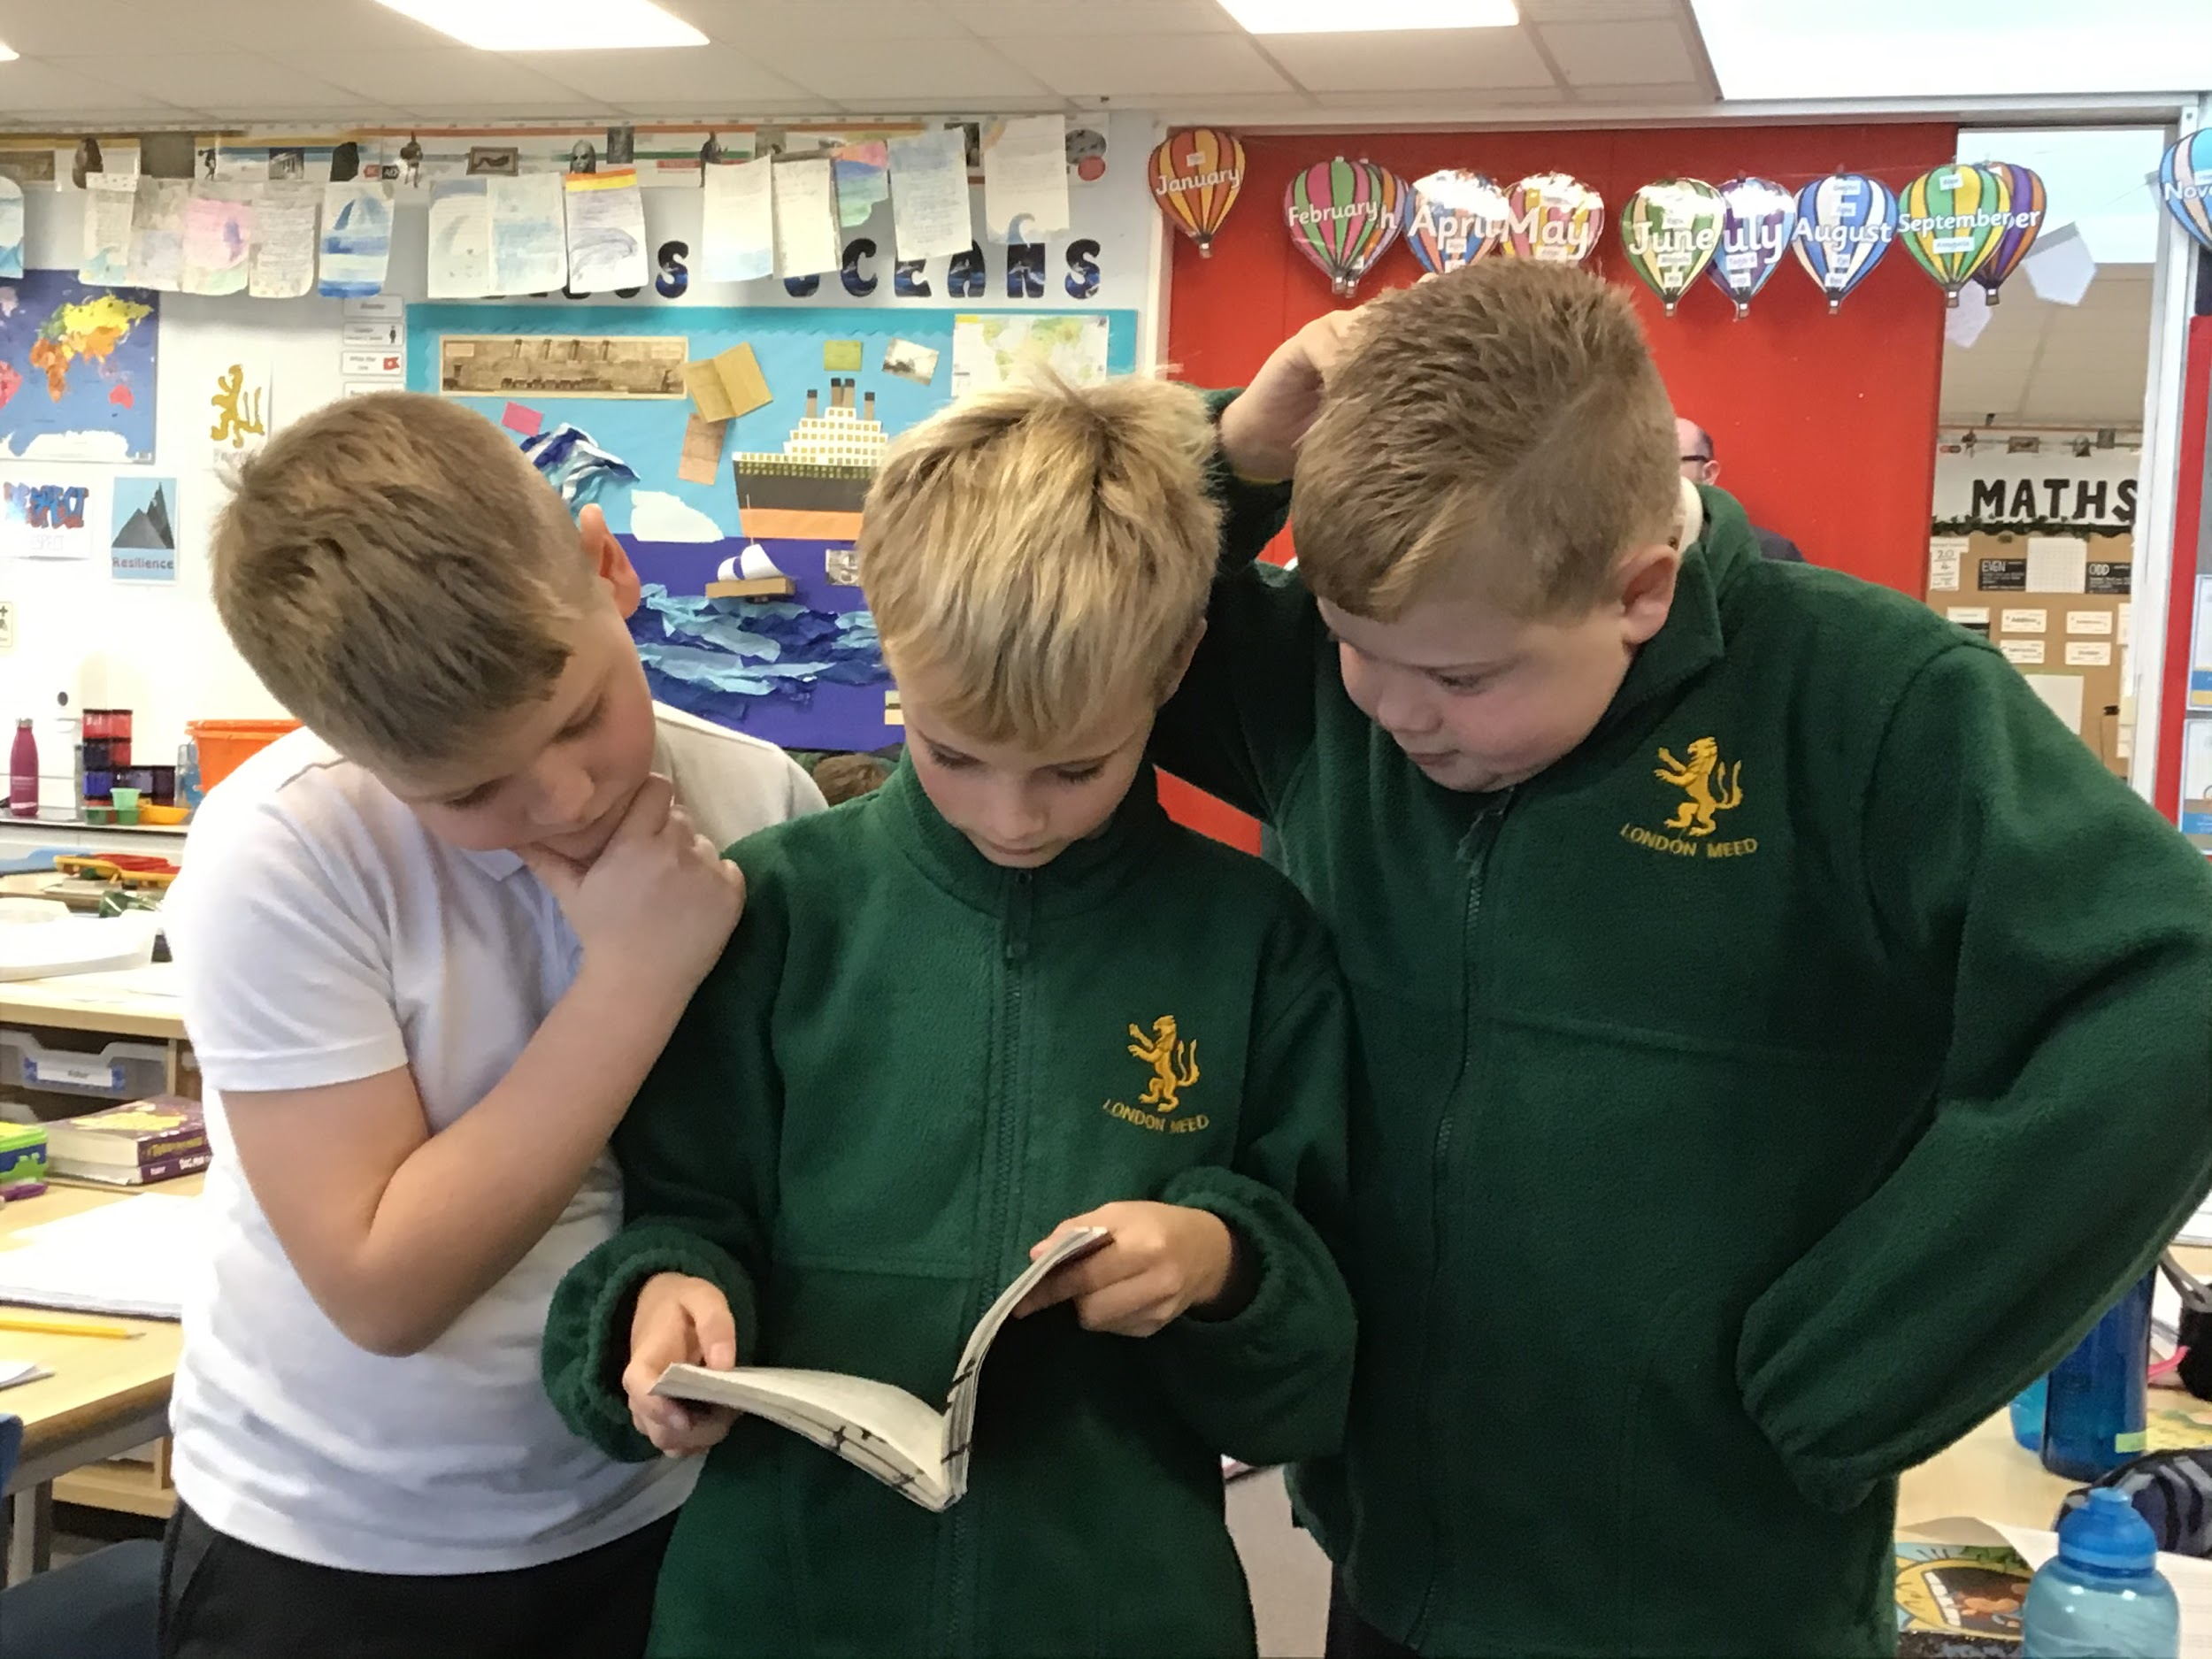
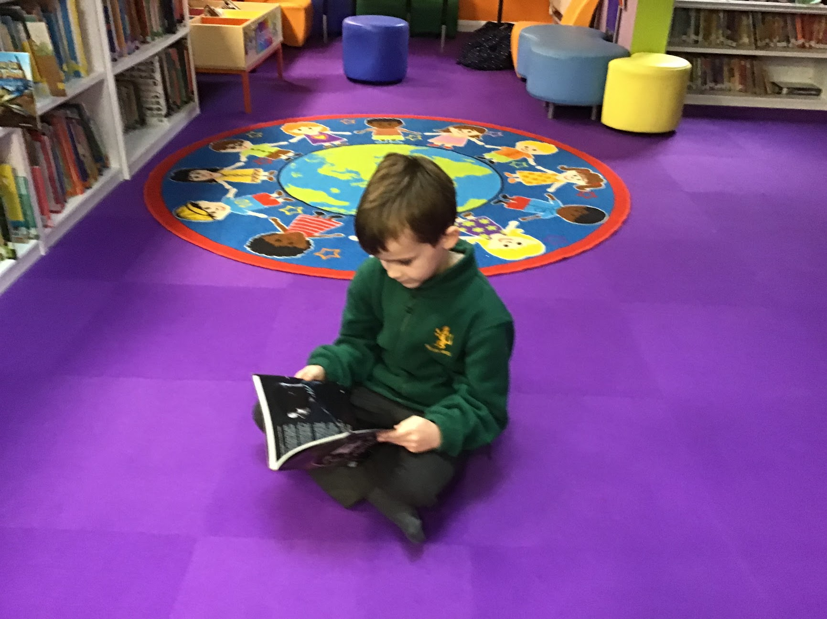
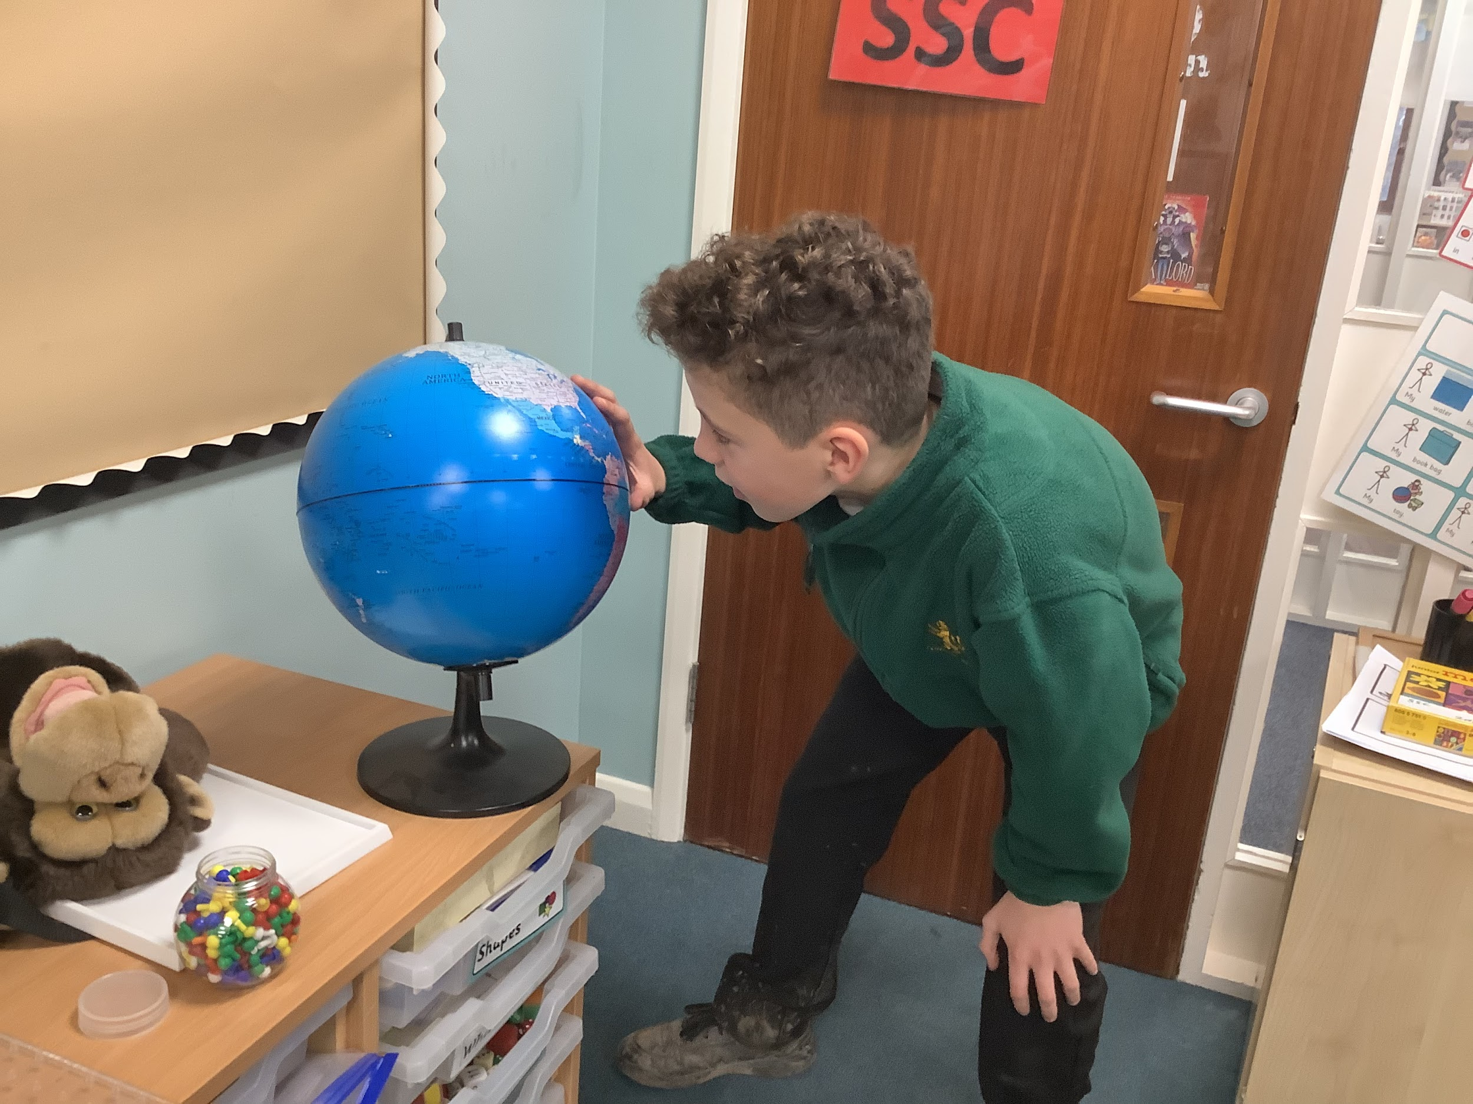
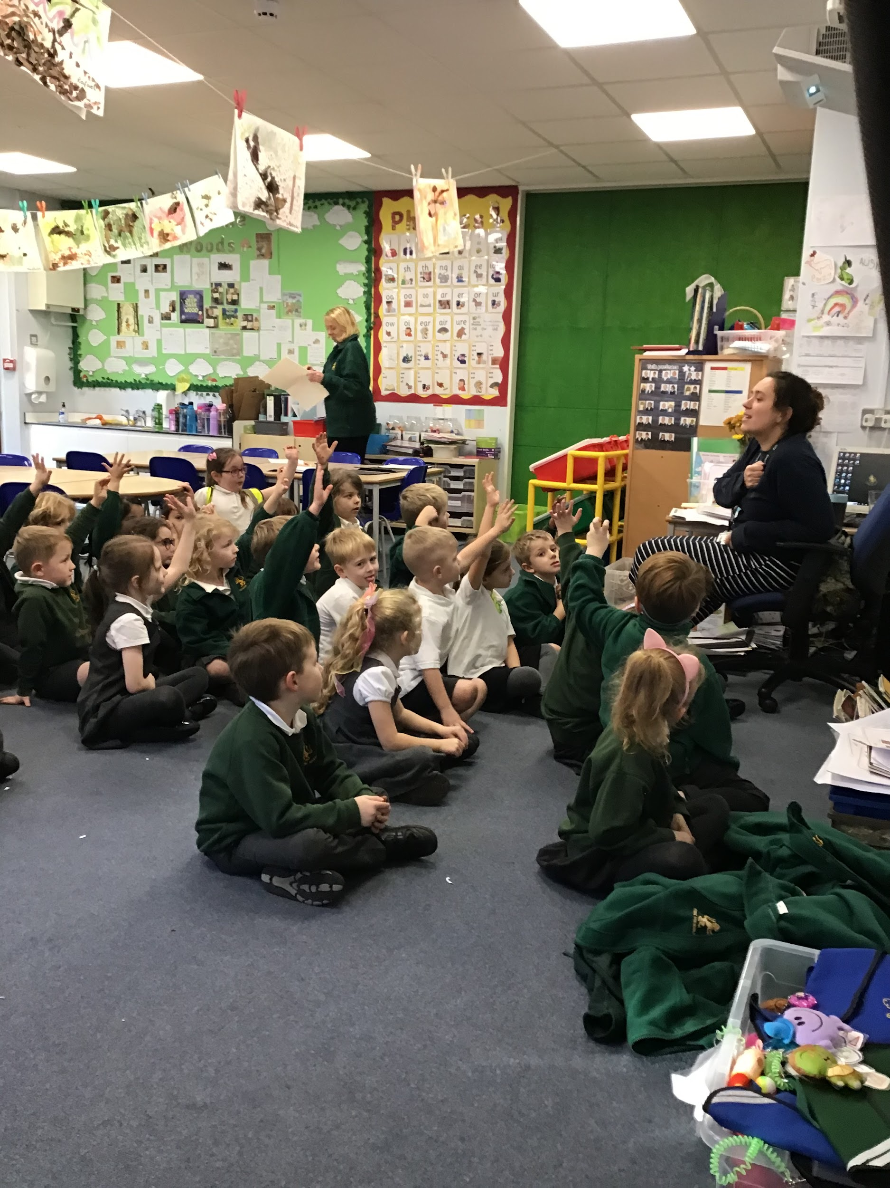
Curiosity

Slide 8
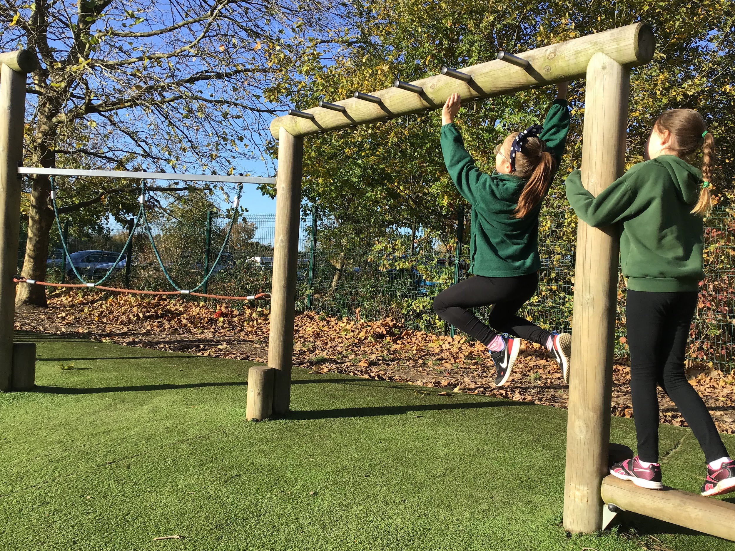
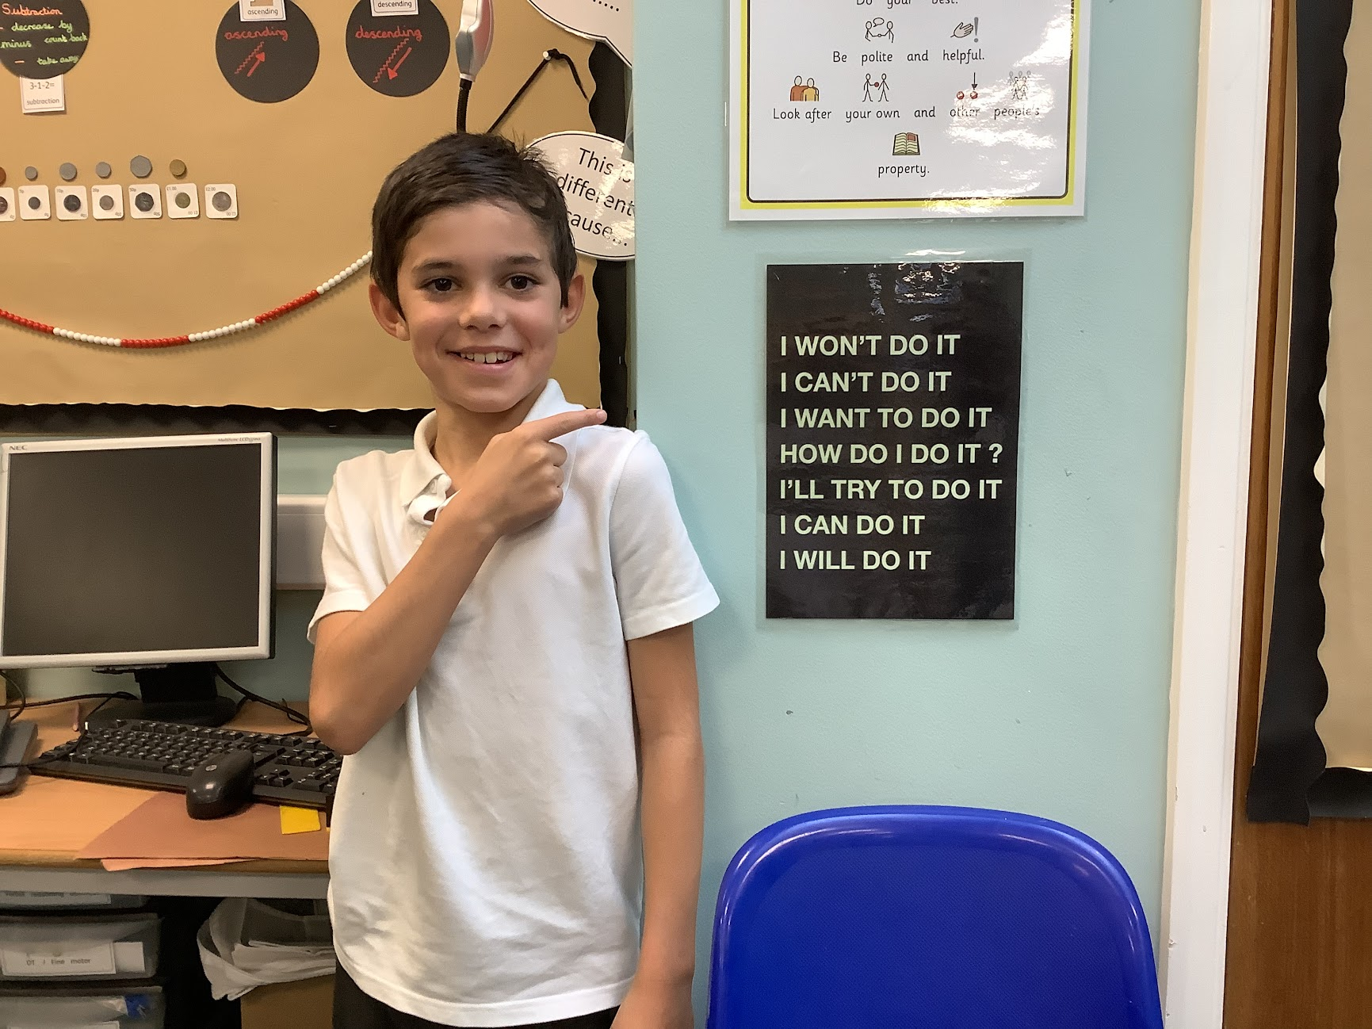
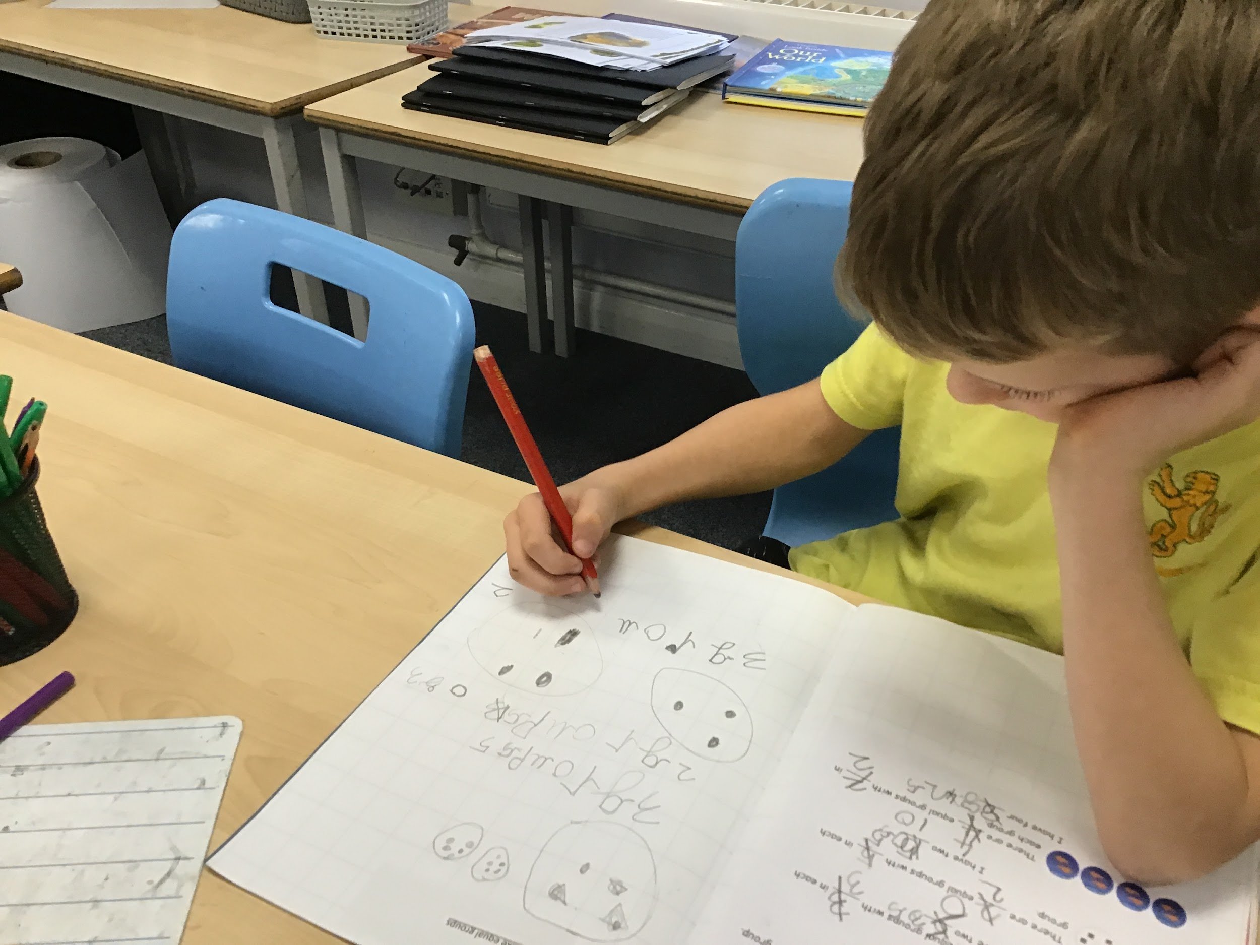
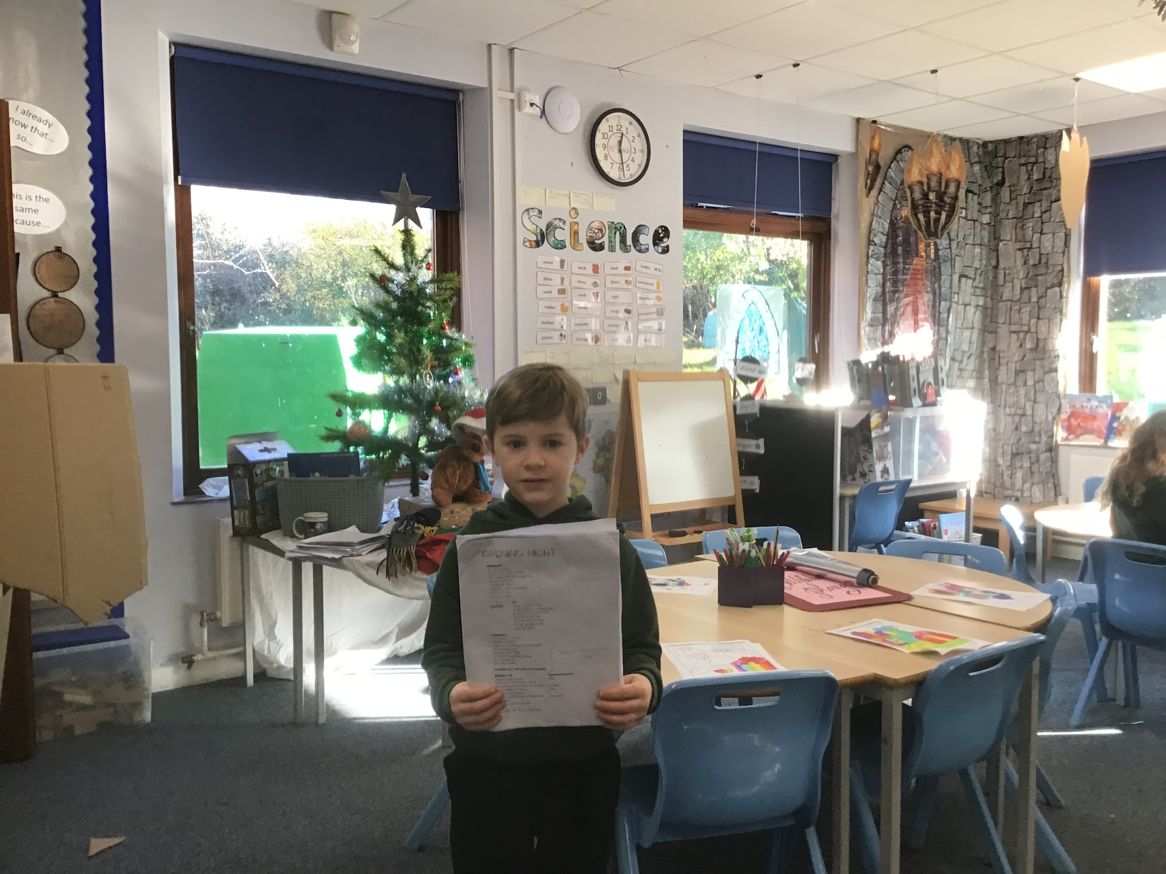
Resilience
Notes:
t

Slide 9
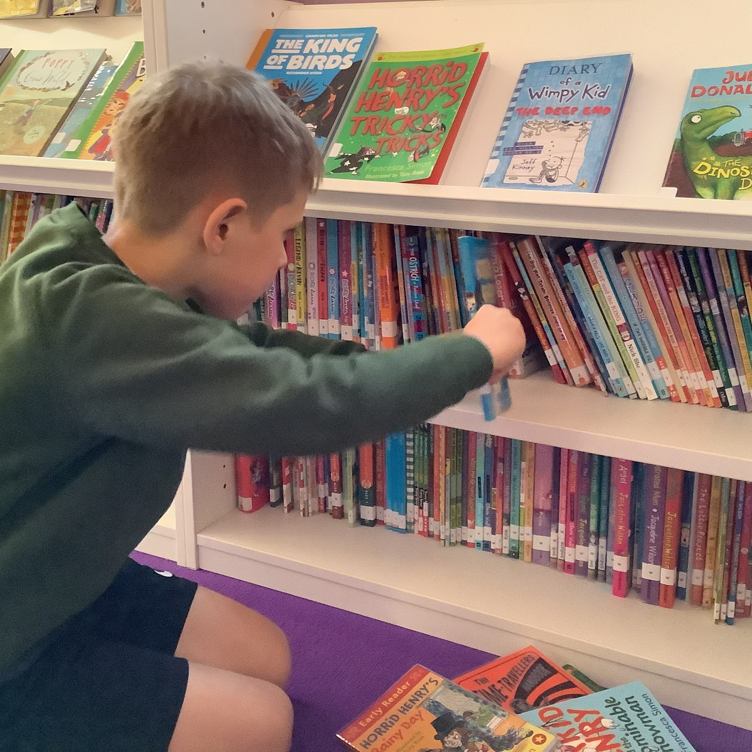
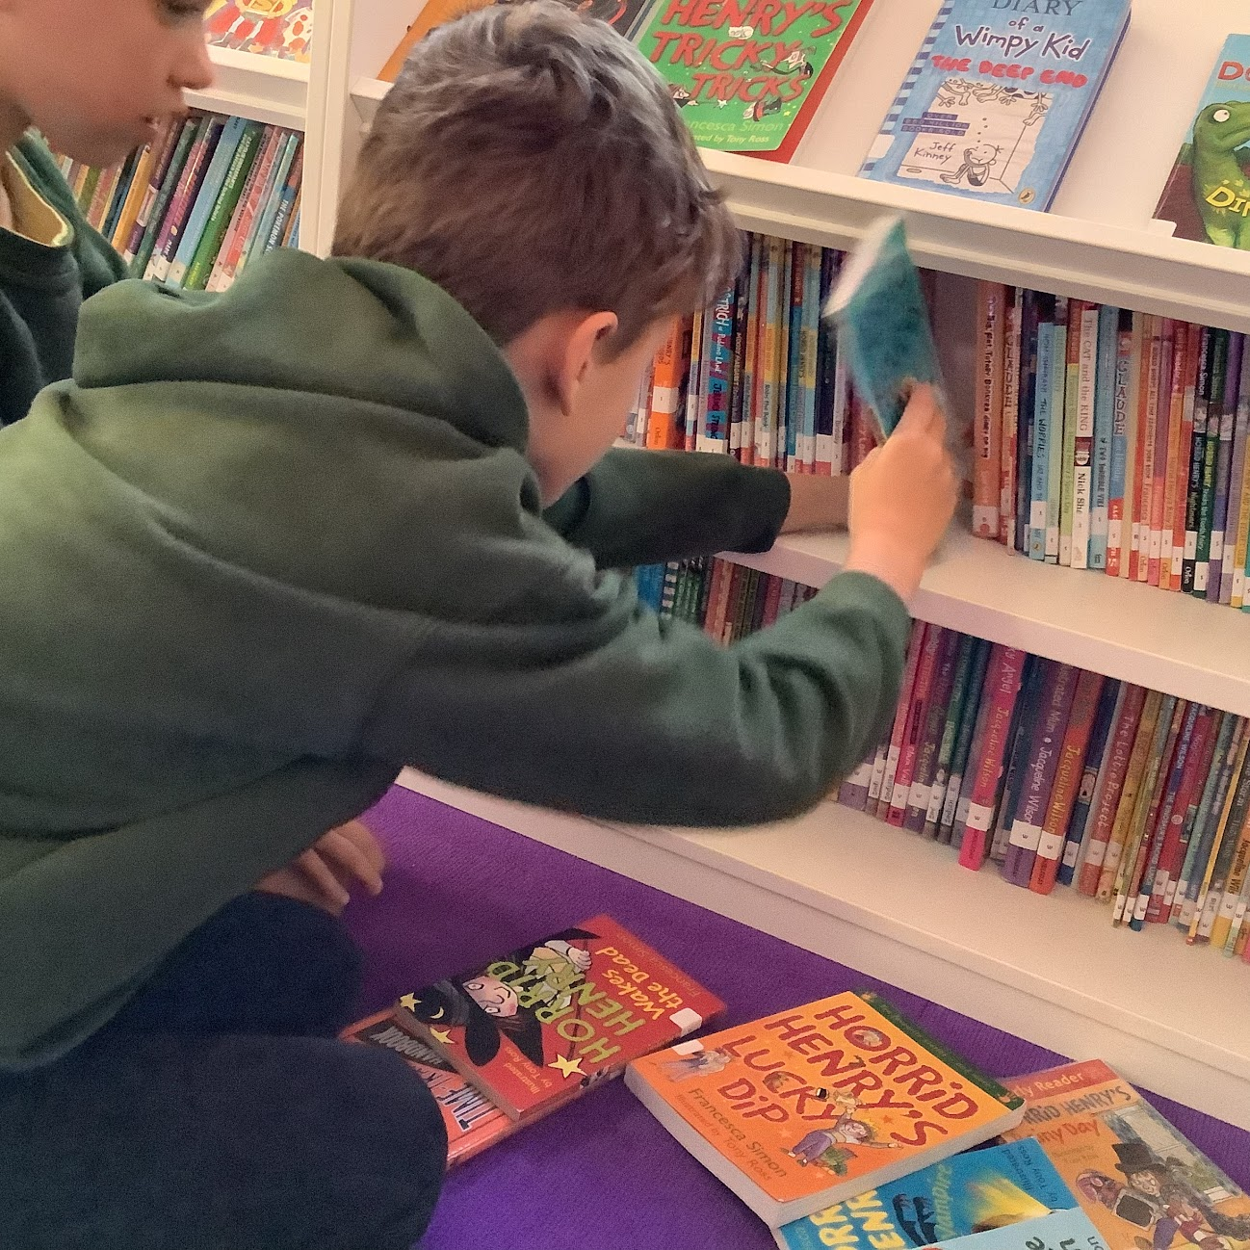
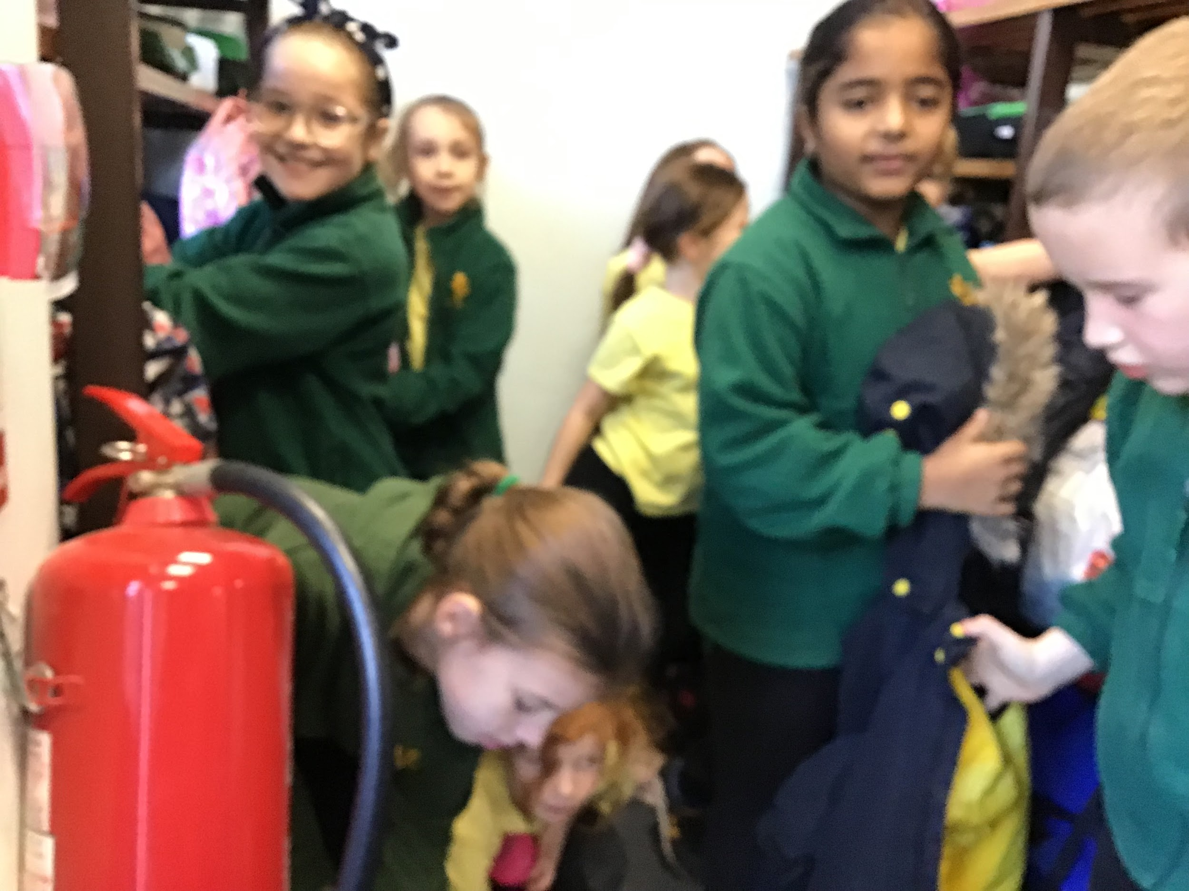
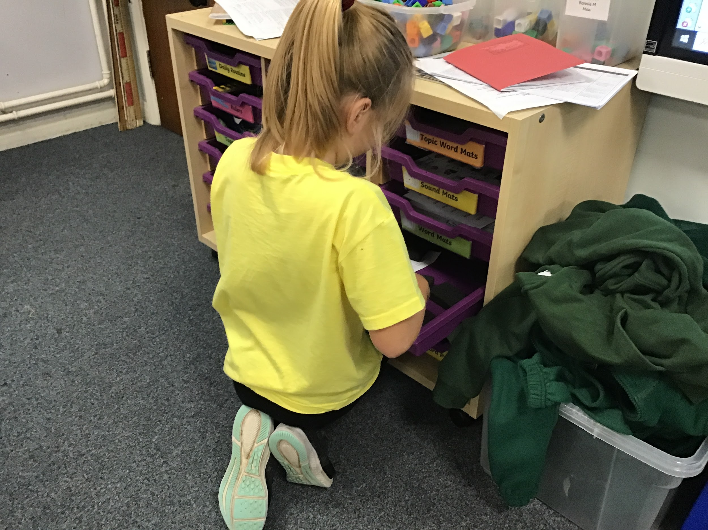
Respect
Respect

Slide 10
What did we learn?
Some Values easier to find than others.
We learned to work with and support each other
We learned about responsibility and that sometimes that can be hard work
We had fun whilst being successful at our task!

Slide 11
What’s next for your Junior Governors?
May include organising a pupil survey, “London Meeds Got Talent” and an Art and DT exhibition?

Slide 12
Thank you
For listening and helping us complete this project
Cannot wait for our next task
Maybe you could be a future Junior Governor?

